Slide 1
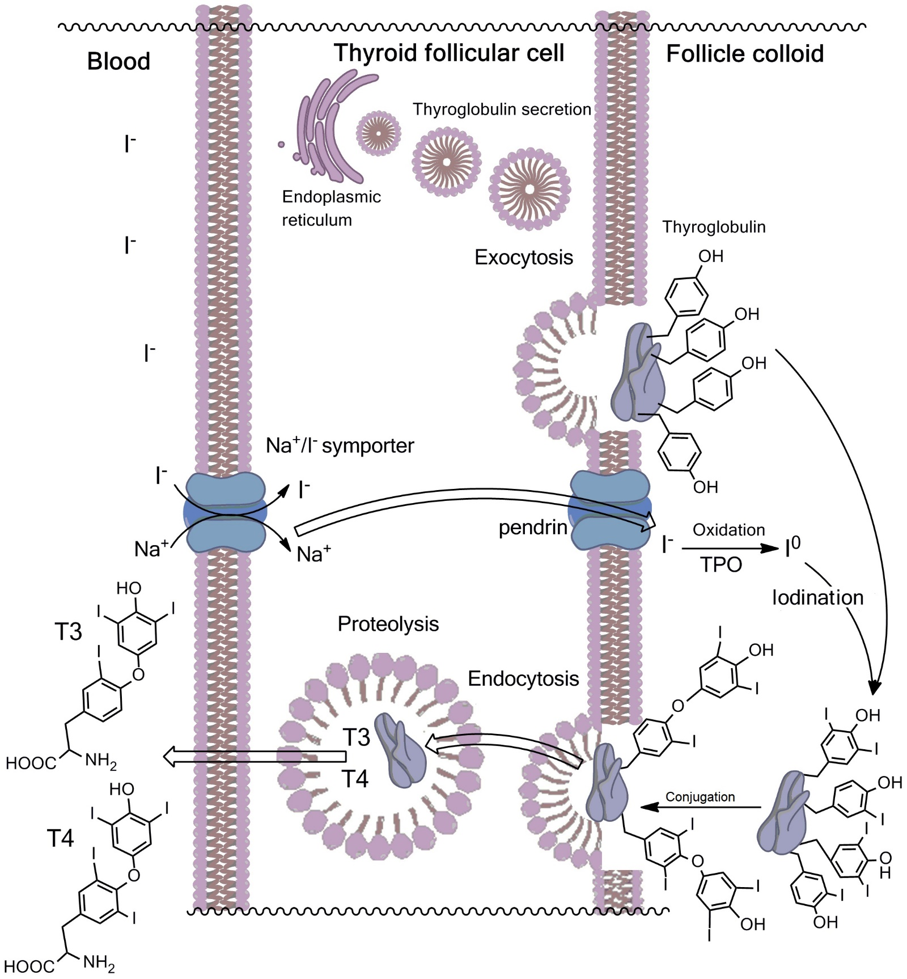
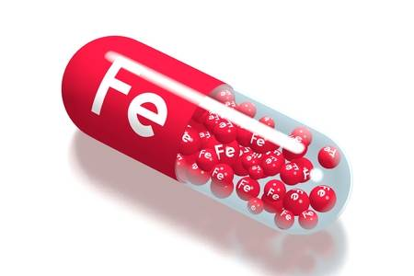
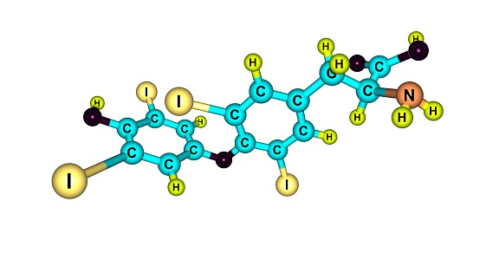
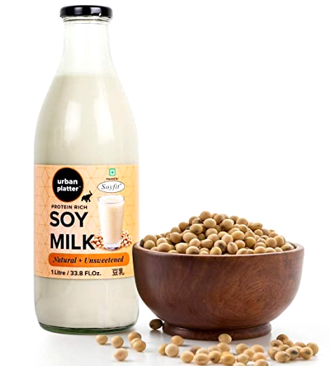
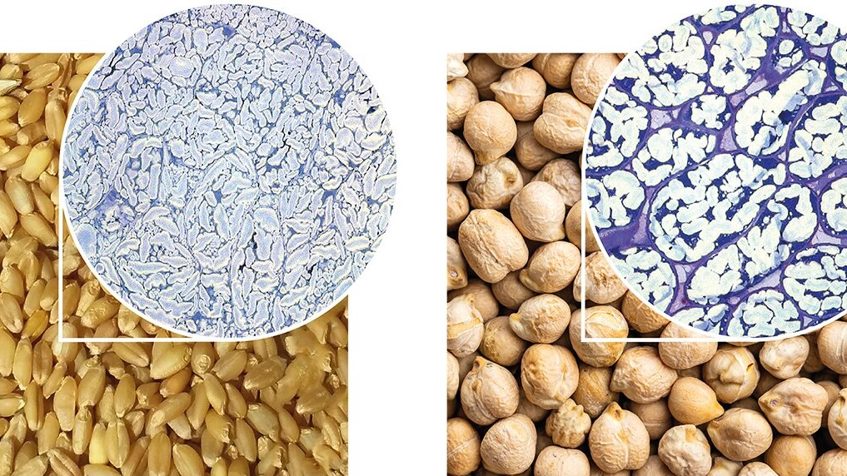
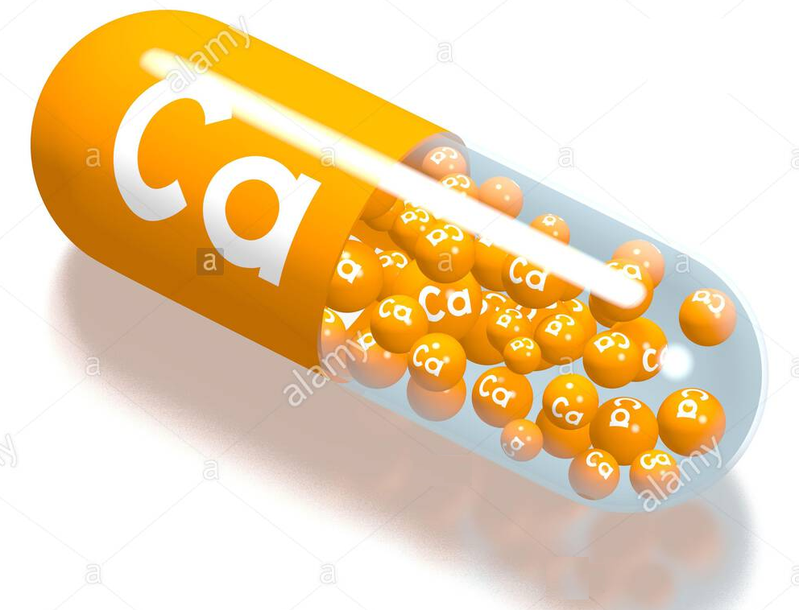
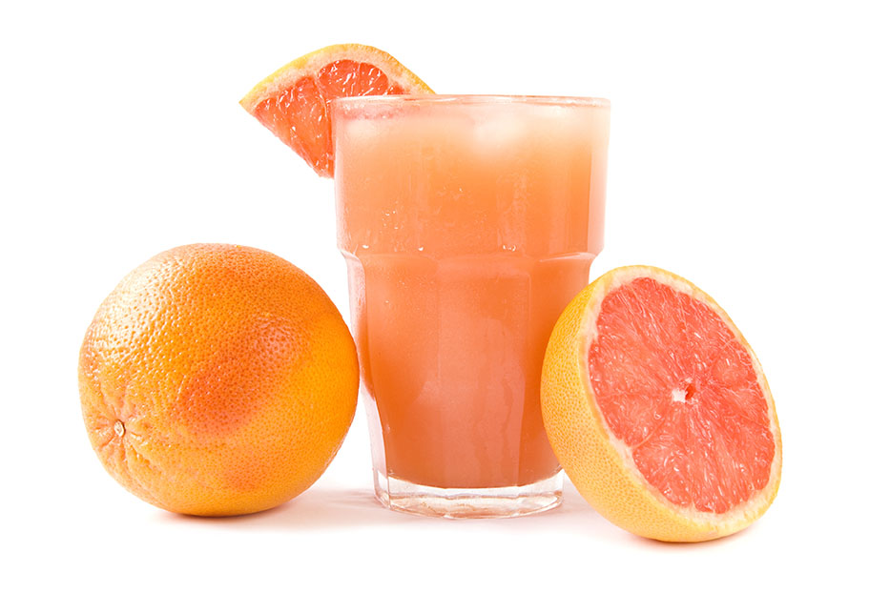
FOOD INTERACTIONS WITH LEVOTHYROXINE
Nataša P. Milošević¹, Maja Lj. Milanović¹, Nataša B. Milić¹, Milica K. Medić Stojanoska²
¹University of Novi Sad, Faculty of Medicine, Department of Pharmacy, Novi Sad, Serbia
²University of Novi Sad, Faculty of Medicine, Clinical Center of Vojvodina, Clinic for Endocrinology, Diabetes and Metabolic Diseases, Novi Sad, Serbia
* Corresponding author: natasa.milosevic@mf.uns.ac.rs
Introduction
Levothyroxine, a synthetic thyroid hormone was the most prescribed drug in the USA in the past three years. Levothyroxine is applied as substitution therapy in hypothyroidism (both primary and central) and also recommended after a thyroidectomy (without hypothyroidism) for the prevention of recurrences, for the inhibition of nodular goitre growth, after an operation of differentiated thyroid carcinoma, as well as after the neck radiation (in cancer prophylaxis). The main aim of this study was to determine the possible interactions of different food with levothyroxine by searching the Pubmed database.
Levothyroxine – food interactions
The absorption of levothyroxine may be decreased by foods such as soy, walnuts, dietary fibres, cottonseed meal, calcium carbonate and iron supplements.
Grapefruit juice delayed the absorption of levothyroxine, but did not affect its overall availability according to a randomized cross-over study (Lilja et al. 2005).
Soy milk reduced the thyroxine plasma levels in two women with congenital hypothyroidism on levothyroxine substitution therapy (Otun et al. 2019).
Both dietary fibres and calcium carbonate by nonspecific adsorption decreased the levothyroxine bioavailability (Liel et al. 1996; Zamfirescu and Carlson, 2011).
Concomitant ingestion of levothyroxine and iron supplements has resulted in the need to increase the levothyroxine dosage in pregnant women (Bungard and Hurlburt, 2007).
The administration of levothyroxine swallowed with coffee/espresso lowered the peak values of thyroxine in the blood plasma, suggesting that the coffee interference with levothyroxine absorption (Benvenga et al, 2008).
substitution
iron supplements
need higher LT4 dose
reduce LT4 plasma levels
Levothyroxine (LT4)
delayed LT4 absorption
decrease LT4 bioavailability
decrease LT4 peak value
soy milk
dietary fibres
calcium carbonate
grapefruit juice
Conclusion
Optimal levothyroxine absorption occurs when the stomach is empty; hence patients should take levothyroxine on an empty stomach 60 minutes before any food intake. The simplest regimen is for the patients to take the levothyroxine daily dosage immediately on waking in the morning with water and an hour before any food intake.
coffee/espresso
References
Benvenga S, Bartolone L, Pappalardo MA, Russo A, Lapa D, Giorgianni G, Saraceno G, Trimarchi F. Altered intestinal absorption of L-thyroxine caused by coffee. Thyroid. 2008;18(3):293-301.
Bungard TJ, Hurlburt M. Management of hypothyroidism during pregnancy. CMAJ. 2007;176(8):1077-8.
Lilja JJ, Laitinen K, NeuvoLiel Y, Harman-Boehm I, Shany S. Evidence for a clinically important adverse effect of fiber-enriched diet on the bioavailability of levothyroxine in adult hypothyroid patients. J Clin Endocrinol Metab. 1996;81(2):857-9.
nen PJ. Effects of grapefruit juice on the absorption of levothyroxine. Br J Clin Pharmacol. 2005;60(3):337-41.
Otun J, Sahebkar A, Östlundh L. et al. Systematic Review and Meta-analysis on the Effect of Soy on Thyroid Function. Sci Rep 2019;9:3964.
Zamfirescu I, Carlson HE. Absorption of levothyroxine when coadministered with various calcium formulations. Thyroid. 2011;21(5):483-6.

